Slide 1
Fundamentals of Big Data Analytics Lecture 3 – Introduction to MapReduce

Slide 2

The problem:
•Big data means … lots of hard drives

Slide 3
The solution:
Lots of data means we should…
bring computation to data!
Intelligent task scheduling and data distribution
Centralized data repository processing

Slide 4
The Map/Reduce Framework
MapReduce is a programming model or pattern within the Hadoop framework that is used to access big data stored in the Hadoop File System (HDFS)

Slide 5
The framework:
• User defines:
a. <key, value>
b. mapper & reducer functions
• Hadoop handles the logistics

Slide 6

The logistics:
• Hadoop handles the distribution and execution

Slide 7

Map/Reduce flow
• map() reads data and outputs <key,value>

Slide 8
Map/Reduce flow
• User defines a reduce function
reduce()

Slide 9

Map/Reduce flow
• reduce() reads <key,value> and outputs
your result

Slide 10
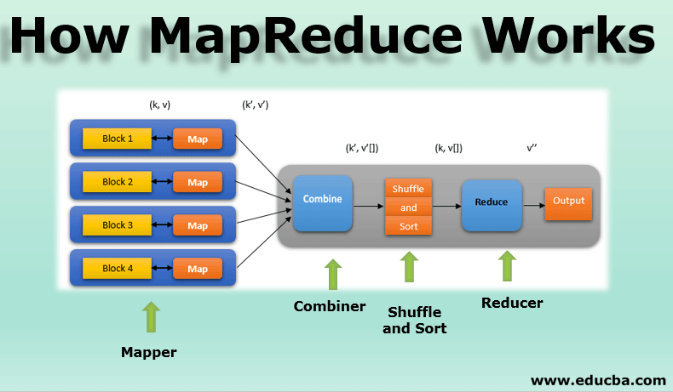

Slide 11
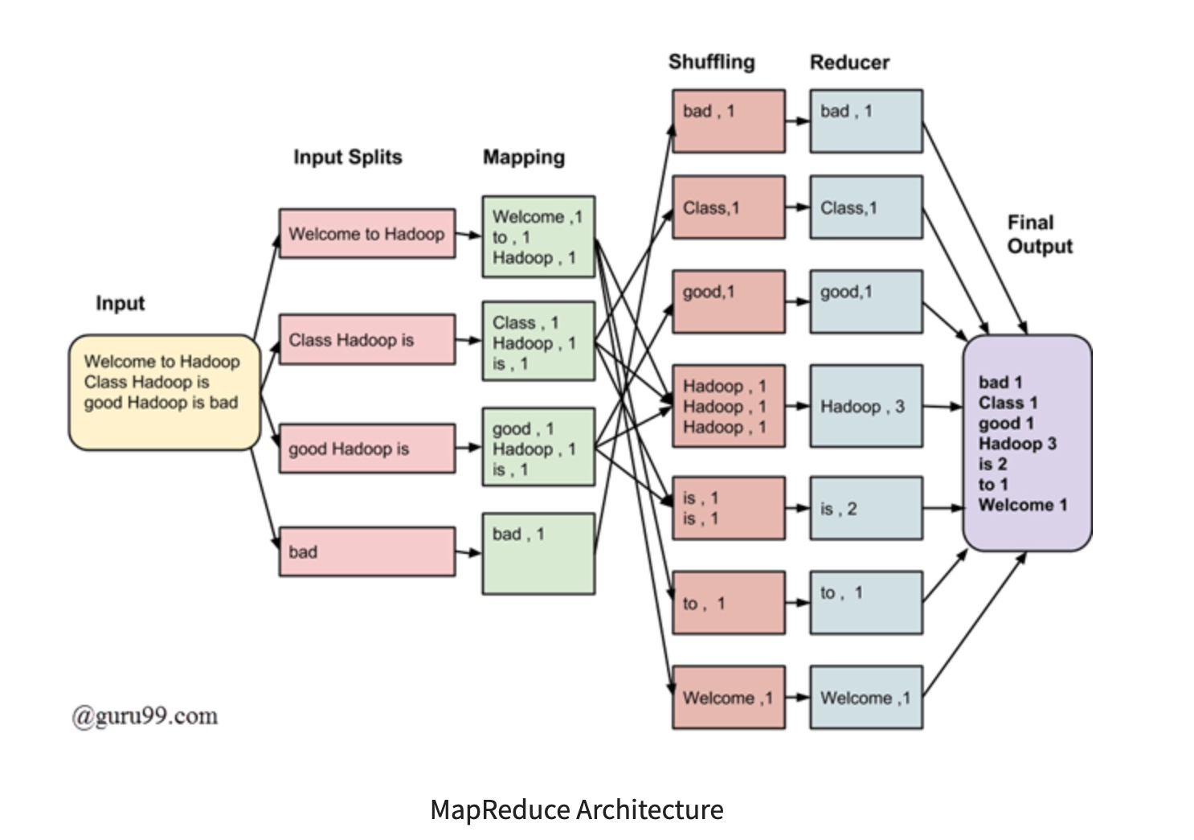

Slide 12

Wordcount task
• … books, blogs, and fan-fiction?

Slide 13
Map/Reduce Strategy
• Let <word, 1> be the <key,value>
• Let Hadoop do the hard work

Slide 14
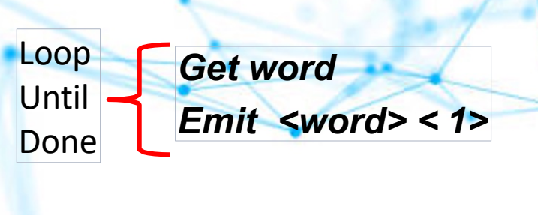
Wordcount Map/Reduce:

Slide 15
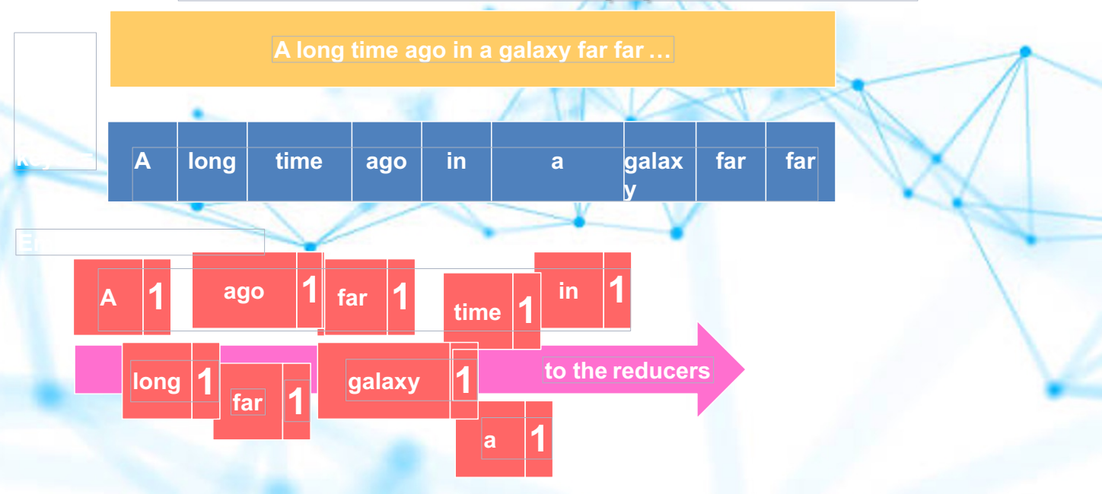
What One Mapper Does

Slide 16
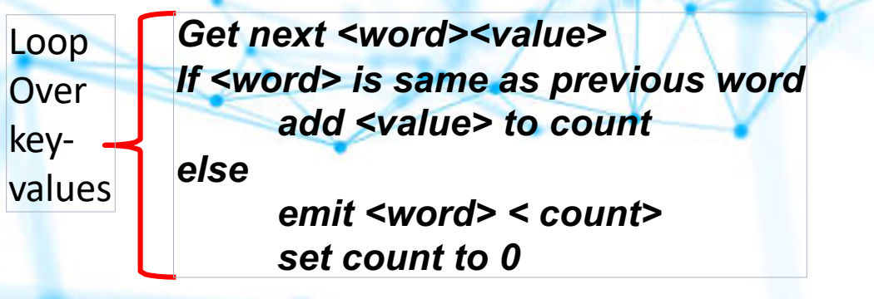
Wordcount Map/Reduce:

Slide 17
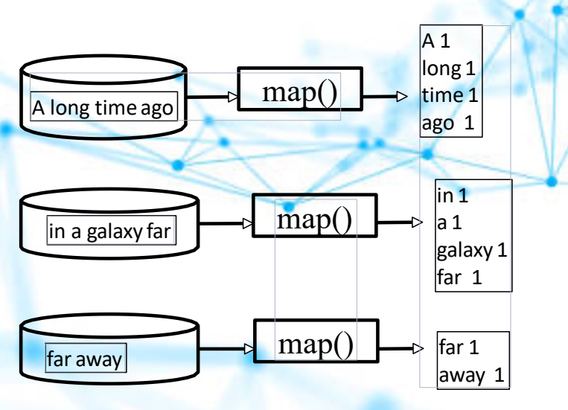
map() output

Slide 18
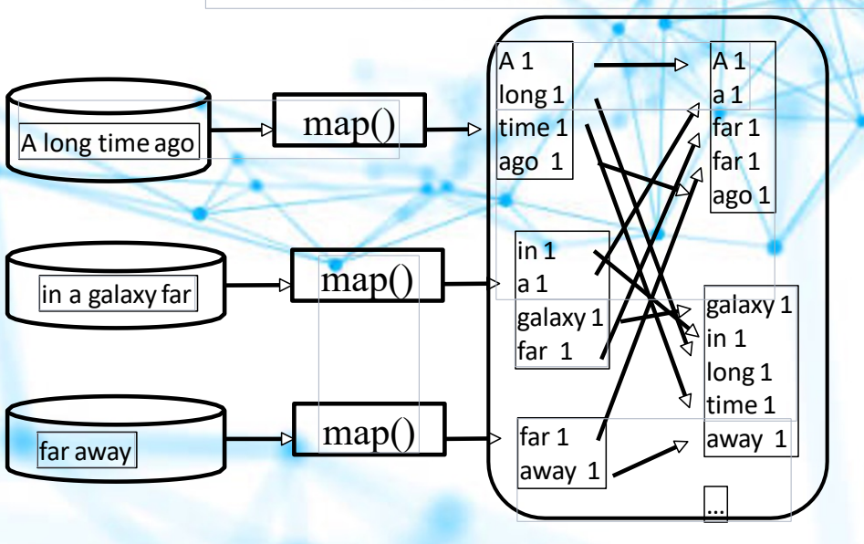
Hadoop shuffles, groups,
and distributes

Slide 19
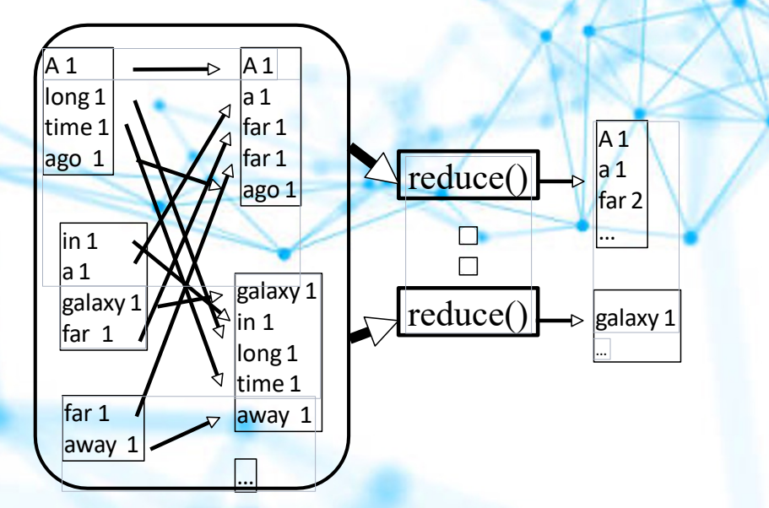
reduce() aggregates

Slide 21
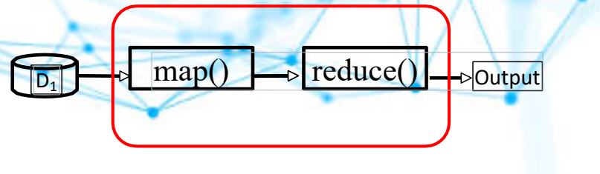
Examples and Principles
User defines <key,value>, mapper, and reducer

Slide 22
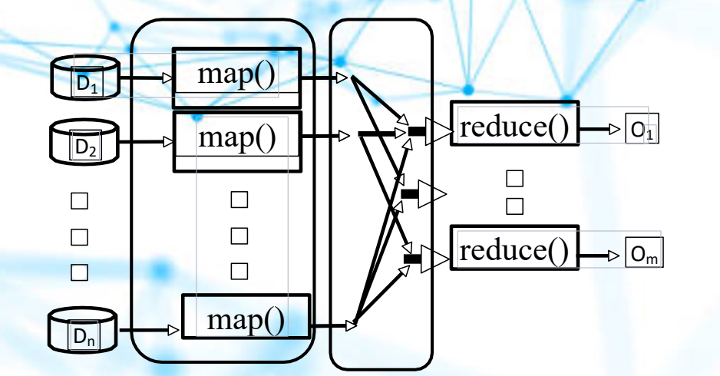
Hadoop handles the logistics

Slide 23
Hadoop Rule of Thumb
1 mapper per data split (typically)
1 reducer per computer core (best parallelism)

Slide 24
Wordcount Strategy
• Let <word, 1> be the <key,value>
• Simple mapper & reducer
• Hadoop did the hard work of shuffling & grouping

Slide 25
Good key-value properties
• Simple
• Enables reducers to get correct output

Slide 26


Good Task Decomposition:
Mappers: simple and separable
Reducers: easy consolidation

Slide 27
Example: Trending Wordcount
Twitter Data: date, message, location, … [other metadata]
Task 1 Get word count by day
Design: Use composite key Map/Reduce: <date word,count>
Task 2 Get total word count
Easy way:
re-use previous wordcount: use Task 1 output (it’s partially aggregated)

Slide 28
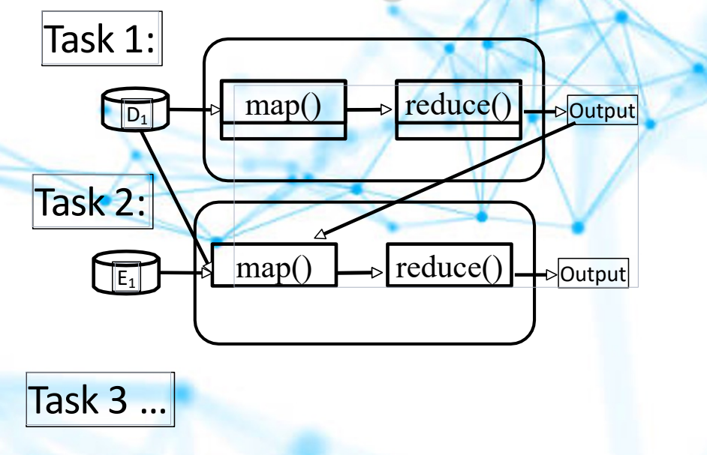
Cascading Map/Reduce

